Slide 1
Unit 203: Electrical installations technology
Water heating

Slide 2
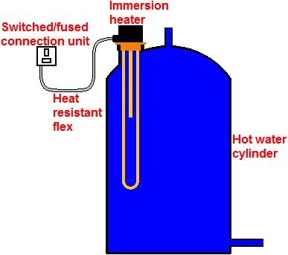
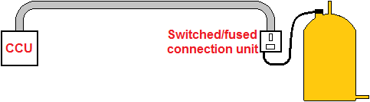
Water heating
Stored hot water

Slide 3
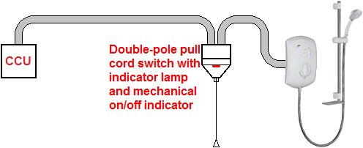
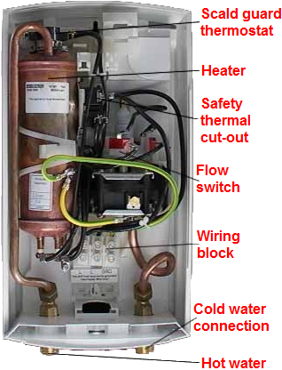
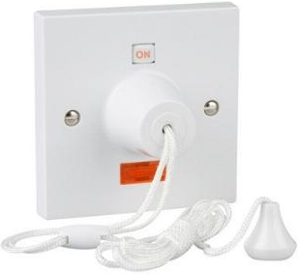
Water heating
Instantaneous water heater

Slide 4
Unit 203: Electrical installations technology
The End

